Slide 1
PHY 105N Lab 6:
Force between two magnets

Slide 2

Magnetic levitation
Because magnets repel, we can use them to levitate other objects
We can use weights with this to determine how the force between magnets depends on distance

Slide 3
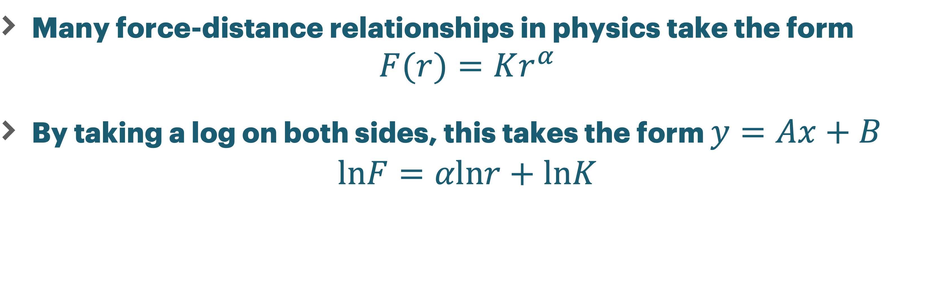
Power Laws
Many force-distance relationships in physics take the form
$$F(r)=Kr^{α}$$
By taking a log on both sides, this takes the form $y=Ax+B$
$$lnF=αlnr+lnK$$

Slide 4
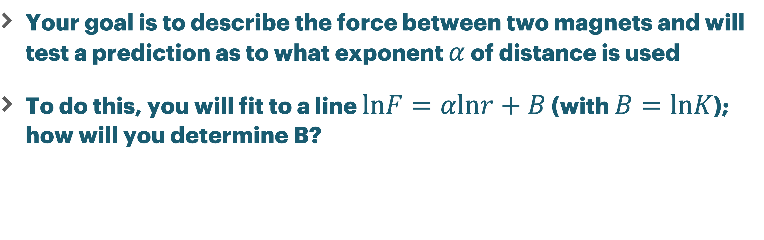
Suggested analysis
Your goal is to describe the force between two magnets and will test a prediction as to what exponent $α$ of distance is used
To do this, you will fit to a line $lnF=αlnr+B$ (with $B=lnK$); how will you determine B?

Slide 5
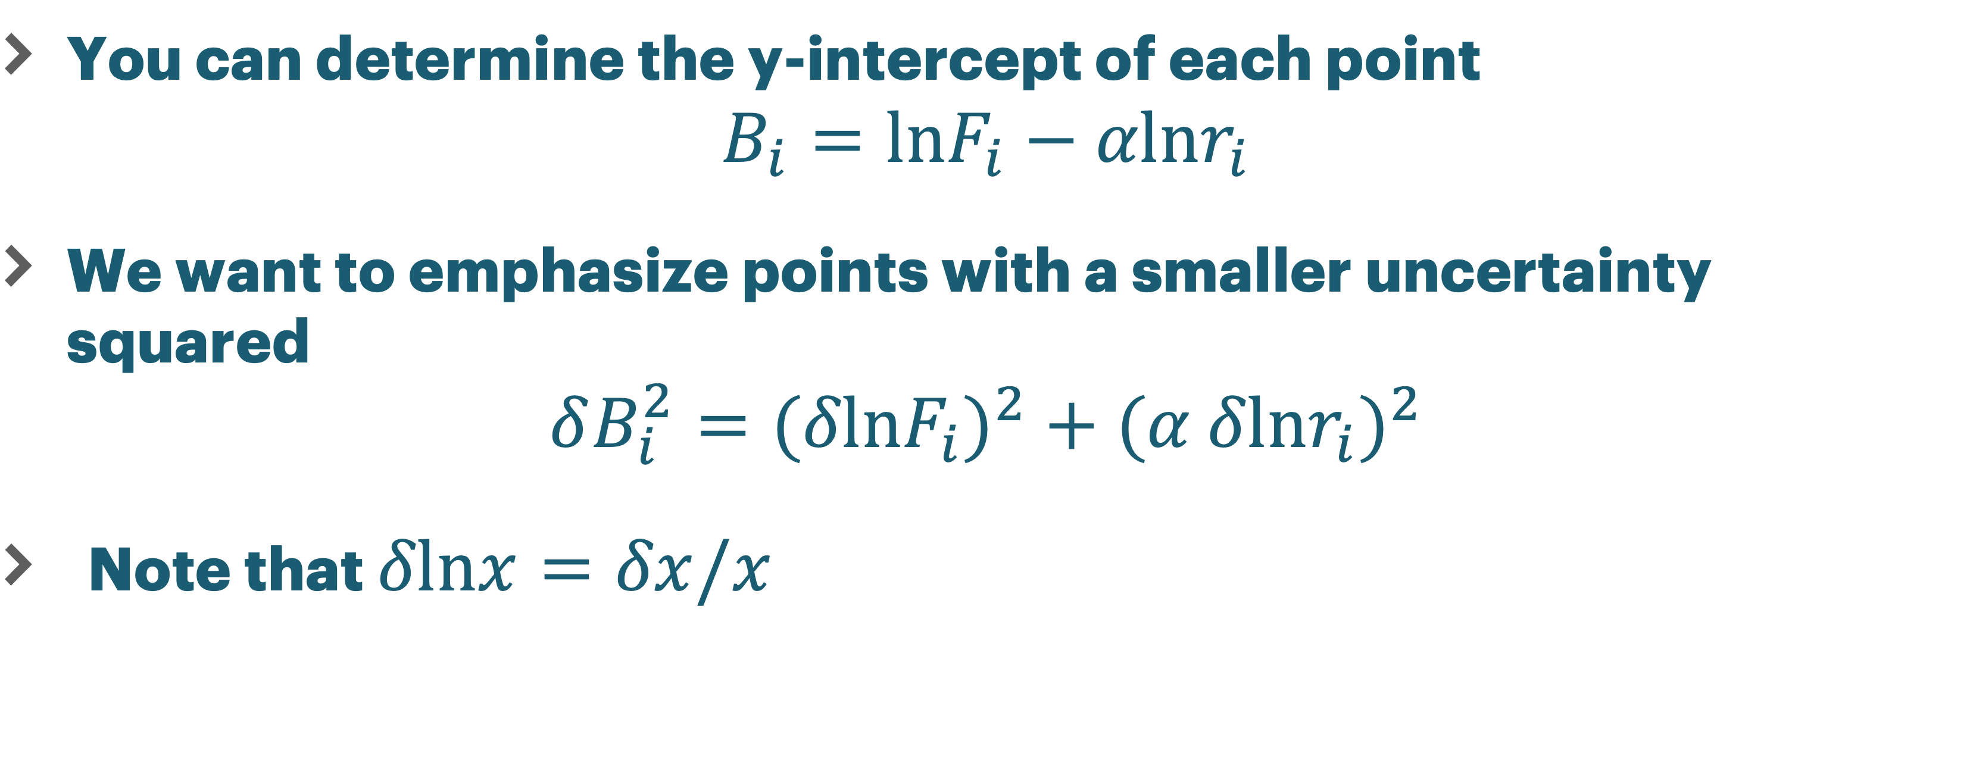
Uncertainty in intercept
You can determine the y-intercept of each point
$$B_{i}=lnF_{i}−αlnr_{i}$$
We want to emphasize points with a smaller uncertainty squared
$$δB_{i}^{2}=(δlnF_{i})^{2}+(α δlnr_{i})^{2}$$
Note that $δlnx=δx/x$

Slide 6
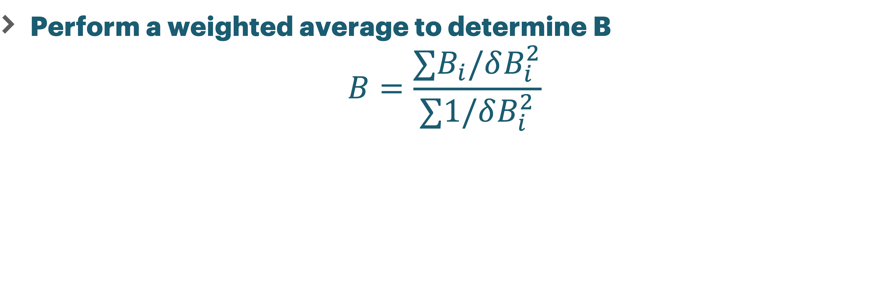
Weighting by inverse square uncertainty
Perform a weighted average to determine B
$$B=\frac{∑B_{i}/δB_{i}^{2}}{∑1/δB_{i}^{2}}$$

Slide 7
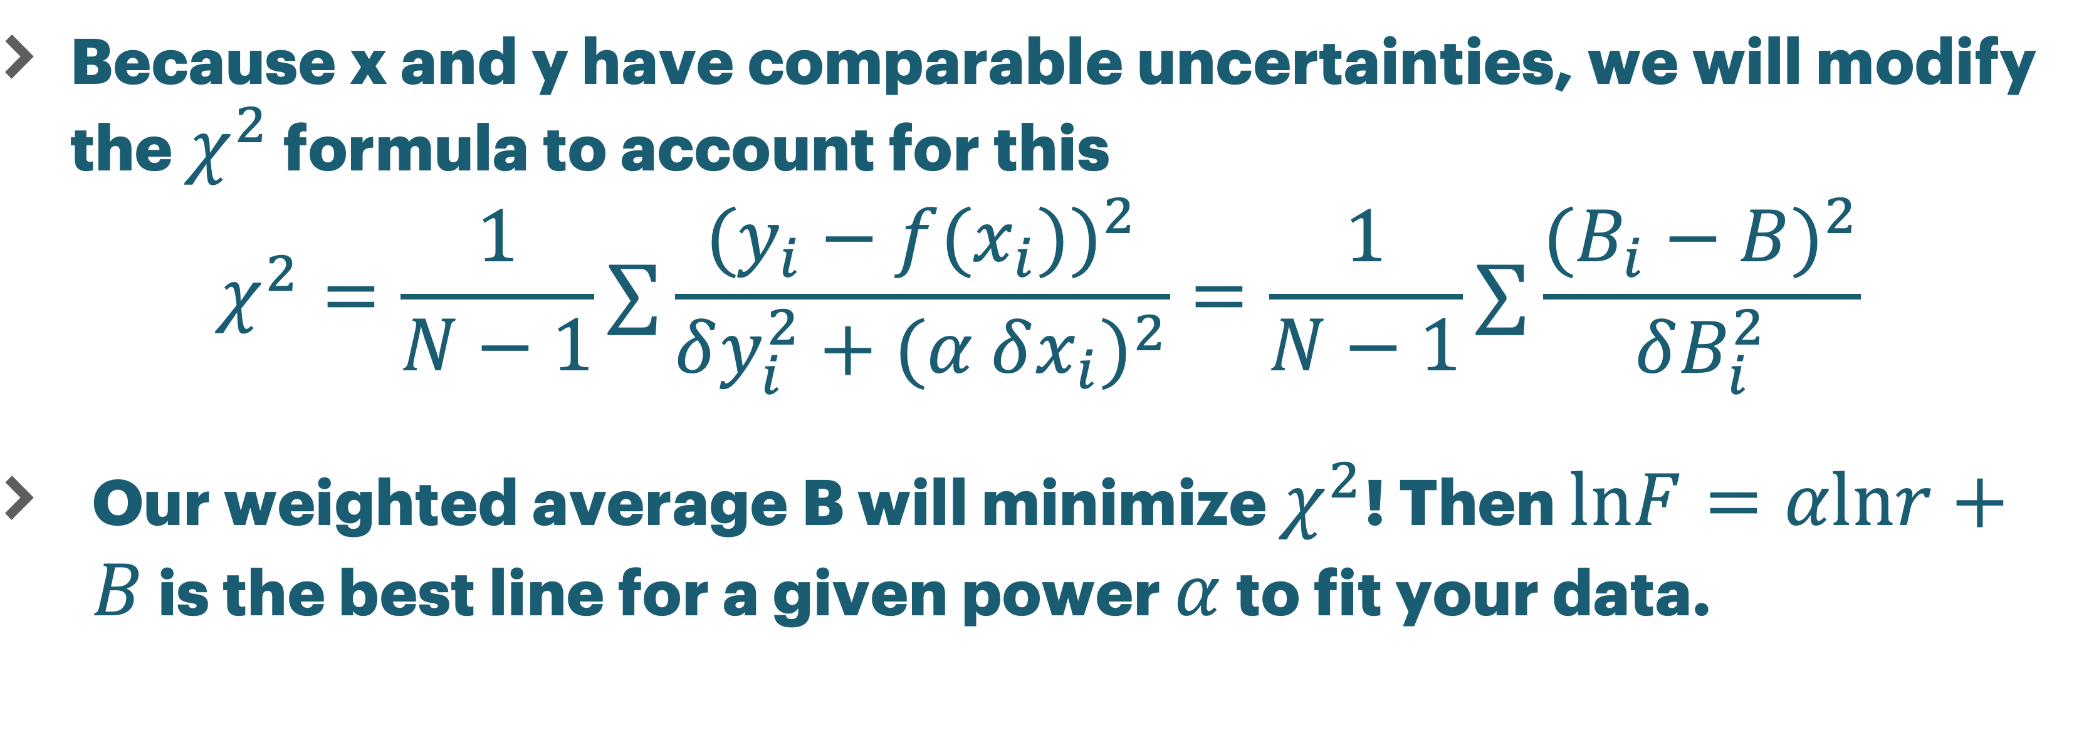
Modified chi squared
Because x and y have comparable uncertainties, we will modify the $χ^{2}$ formula to account for this
$$χ^{2}=\frac{1}{N−1}∑\frac{(y_{i}−f(x_{i}))^{2}}{δy_{i}^{2}+(α δx_{i})^{2}}=\frac{1}{N−1}∑\frac{(B_{i}−B)^{2}}{δB_{i}^{2}}$$
Our weighted average B will minimize $χ^{2}$! Then $lnF=αlnr+B$ is the best line for a given power $α$ to fit your data.

Slide 8
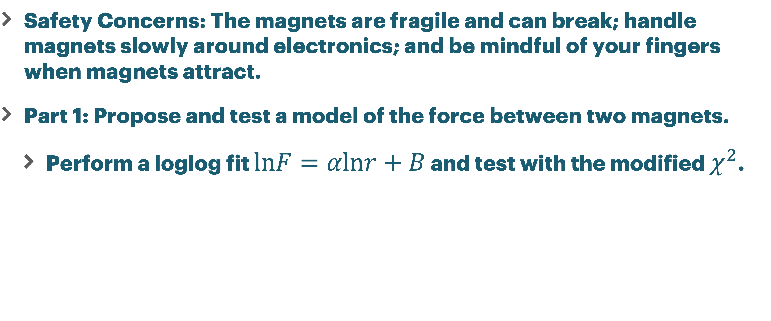
Expectations
Safety Concerns: The magnets are fragile and can break; handle magnets slowly around electronics; and be mindful of your fingers when magnets attract.
Part 1: Propose and test a model of the force between two magnets.
Perform a loglog fit $lnF=αlnr+B$ and test with the modified $χ^{2}$.

Slide 9
Part 2
Modify your predicted exponent as necessary.
Part 2: Evaluate the results of Part 1 and decide what you should test:
What happens if you change the number of magnets?
Focus on far/close distances.
What changes if you add an object between the magnets?
Can you better account for your uncertainty? Other ideas?

